Slide 1

Garbage Monitoring Using IoT
Vamshinath M
14B81A12B1 - IT
CVR College of Engineering

Slide 2
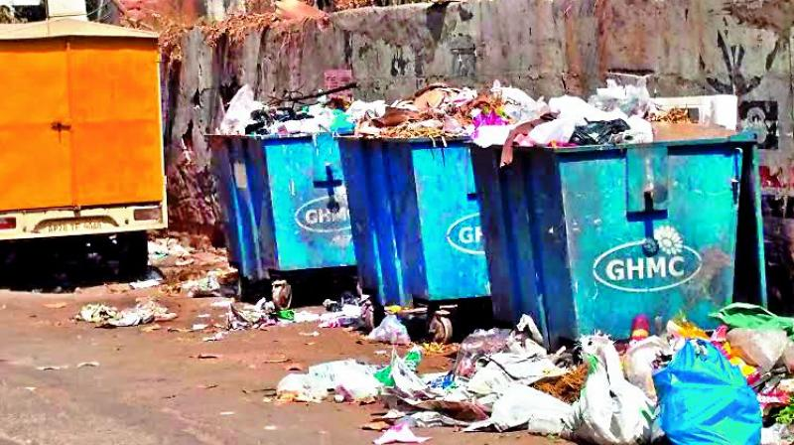
The Main Problem:

Slide 3



SOLUTION :

Slide 4

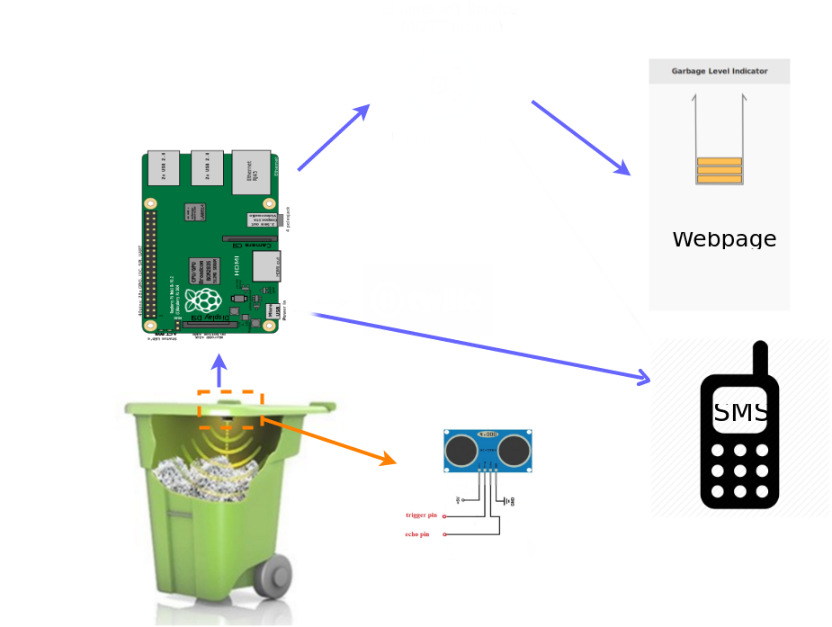

Slide 5

Hardware:

Slide 6
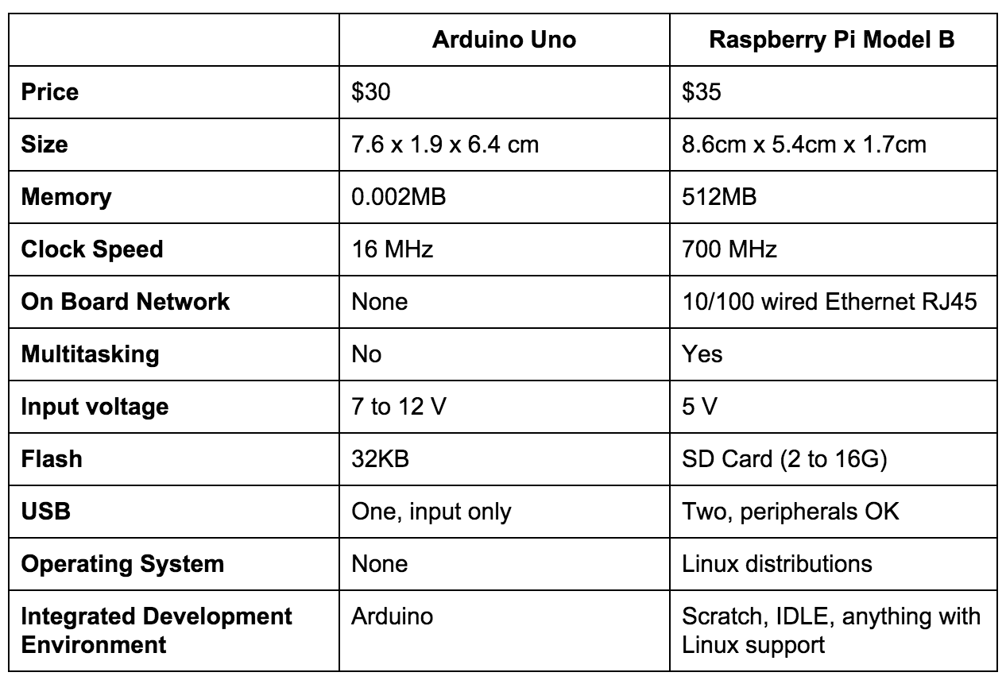

Slide 7


Software:

Slide 8

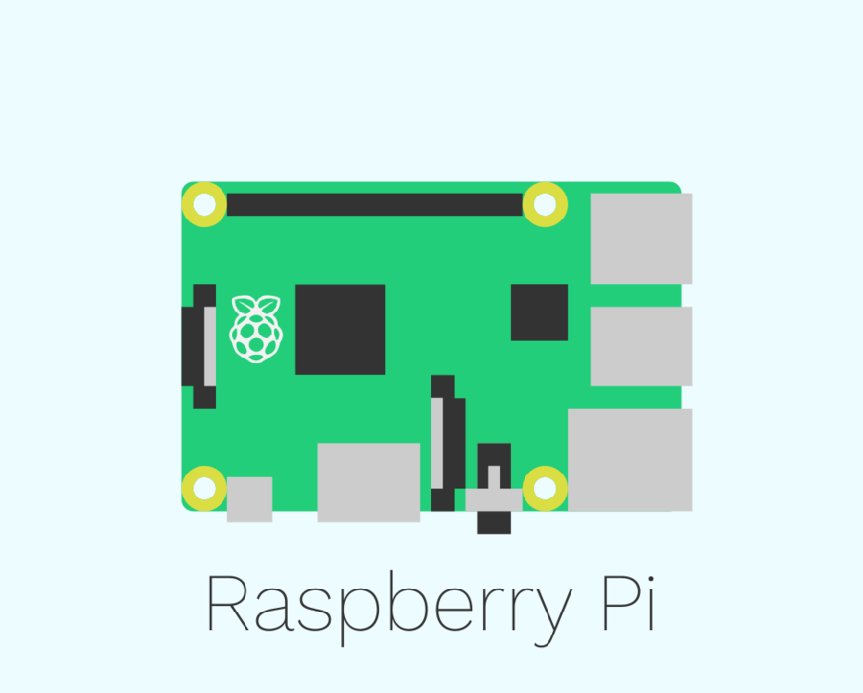
Server side :

Slide 9
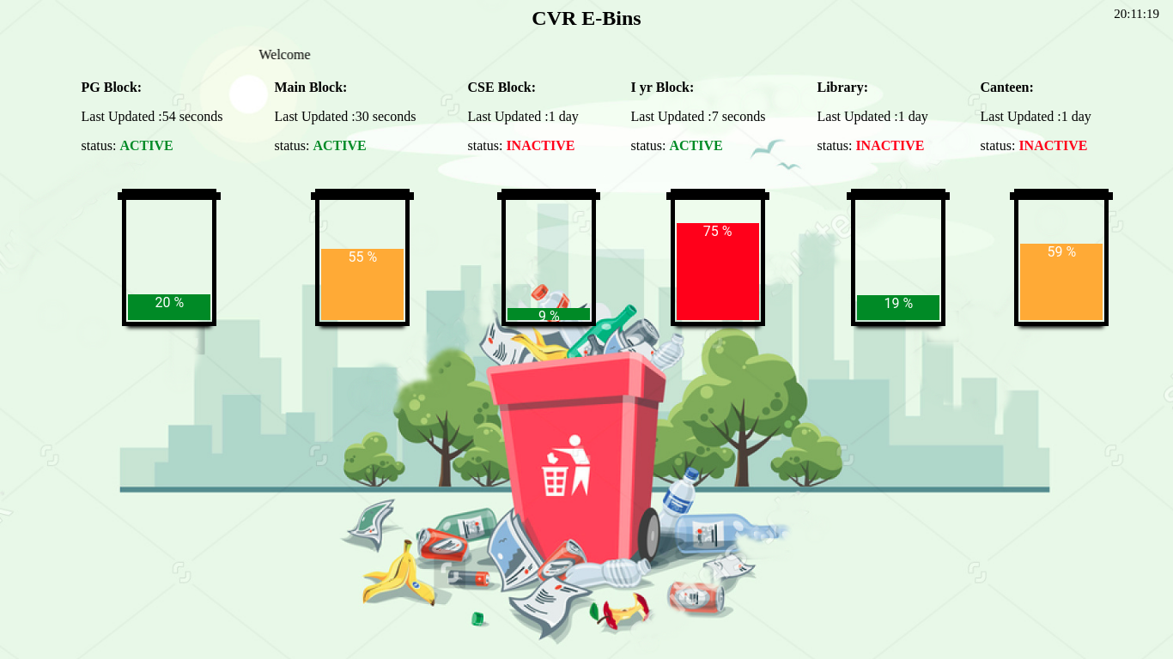

Slide 10

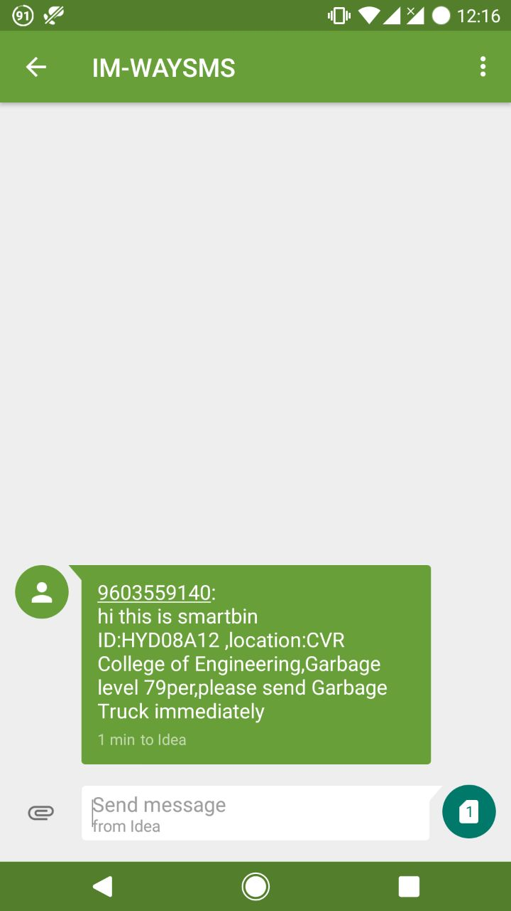

Slide 11

We made this Project on Github !!
https://github.com/vamshinath/college_project

Slide 12


Slide 13


